Slide 1

Can we predict diabetes?
Kiran Komati
College of Science and Technology, Bellevue University
DSC630 – Predictive Analytics
Dr. Fadi Alsaleem
August 13th, 2022
Notes:
Delete this slide when you finish preparing the other slides.

Slide 2

summary
Introduction
What is Diabetes
Data source
Types of Models
Model Building
Evaluation
Conclusion

Slide 3
Introduction
What is Diabetes?
Group of metabolic disorders in which there are high blood sugar levels over a prolonged period
Symptoms include frequent urination, increased thirst, and increased hunger
Complications include damage to the eyes, cardiovascular disease, stroke, chronic kidney disease, foot ulcers, and severity can lead to death.
Objective
predict if a patient has diabetes, based on certain diagnostic measurements included in the dataset

Slide 4
Introduction
Data Source
Originally from the National Institute of Diabetes and Digestive and Kidney Diseases
Attributes
Number of times pregnant
Plasma glucose concentration 2 hours in an oral glucose tolerance test
Diastolic blood pressure (mm Hg)
Triceps skin fold thickness (mm)
2-Hour serum insulin (mu U/ml)
Body mass index (weight in kg/(height in m)^2)
Diabetes pedigree function
Age (years)
Class variable (0 or 1)

Slide 5

Data modelling
Data Models
Logistic regression
Decision Tree Classifier
Steps performed
Load the data set into a data frame.
Perform the EDA to understand the characteristics of the data set.
Evaluate the correlation between the variables in the dataset.
Divide the data set into a train and test data set and apply a model.
Create a confusion matrix to show the performance of the model to evaluate the predicted values from the model vs. the actual values from the test dataset.

Slide 6
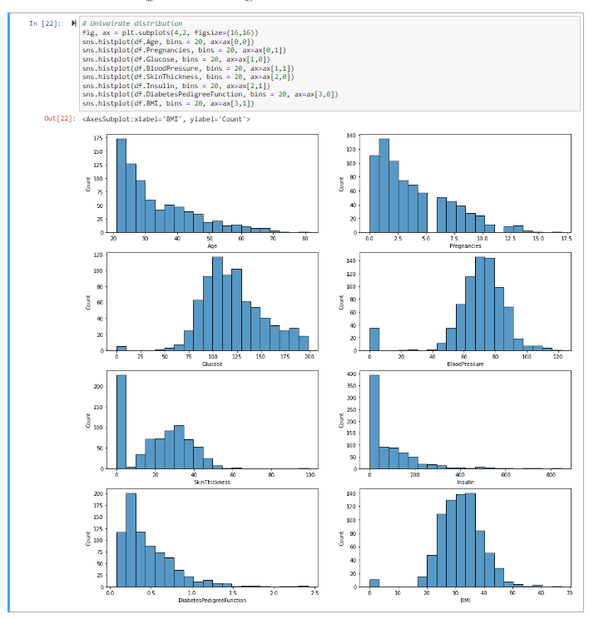
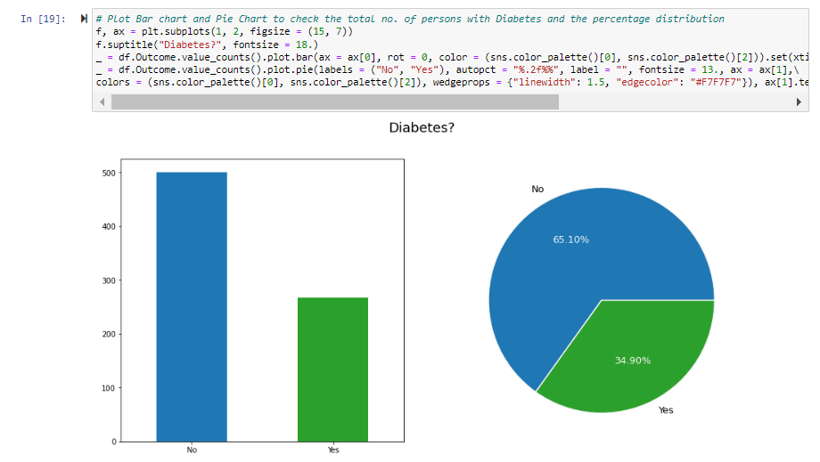
Exploratory data analysis
Figure 1: Bar Chart
Figure 2: Pie Chart
Figure 3: Histograms

Slide 7
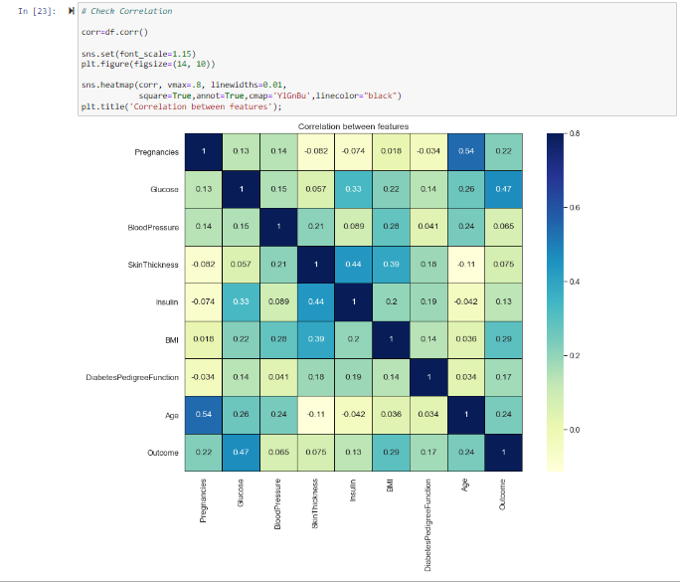
Check correlation
Figure 4: Correlation

Slide 8
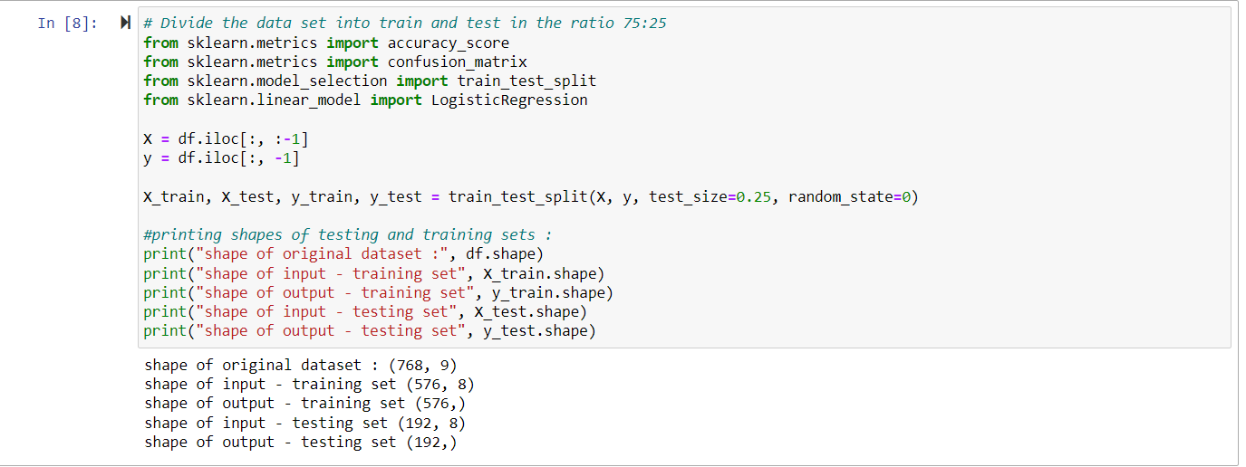
Data Preparation
Check for NULLs
Check for Categorical Columns
Divide the data set into train and test sets

Slide 9

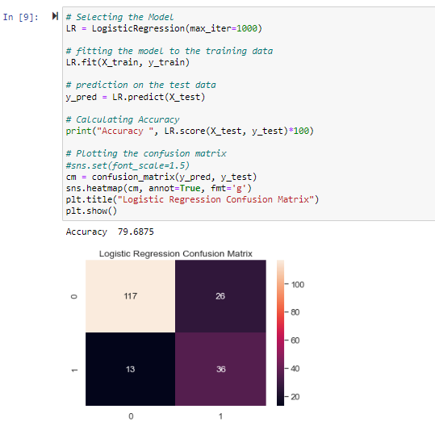
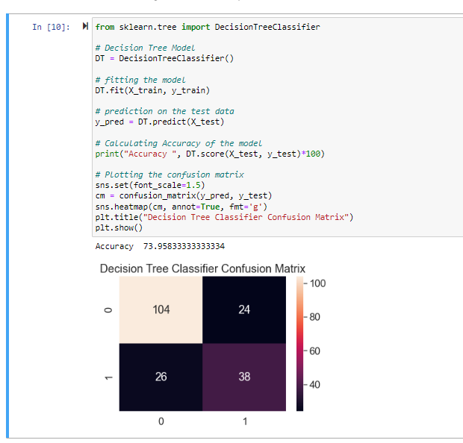
Build and evaluation

Slide 10
Conclusion
Accuracy
Logistic Regression – 79.6
Decision Tree – 73.9
Model is not ready for deployment yet
Needs to be tested extensively with large data sets
Other models also needs to be evaluated

Slide 11
references
https://data.world/uci/pima-indians-diabetes
https://www.kaggle.com/code/rishpande/pima-indians-diabetes-beginner/data
https://www.techtarget.com/searchbusinessanalytics/definition/logistic-regression

